Slide 1
Triangular mesh generation from 2D CT image
Arjun Kumar, Bo Ning, Xiaodong Wei

Slide 2
Outline
Problem Definition
Application: Fuel cells
Input: CT Image
Output: Triangular mesh of 2D slice
Uniform and adaptive
Pre-processing
Quadtree subdivision
Algorithm
Marching Squares
Implementation
Results

Slide 3
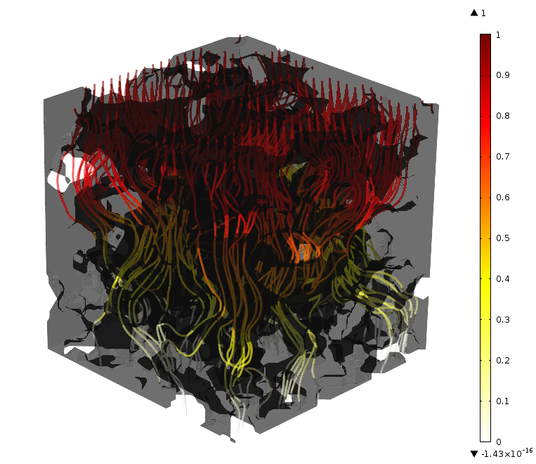
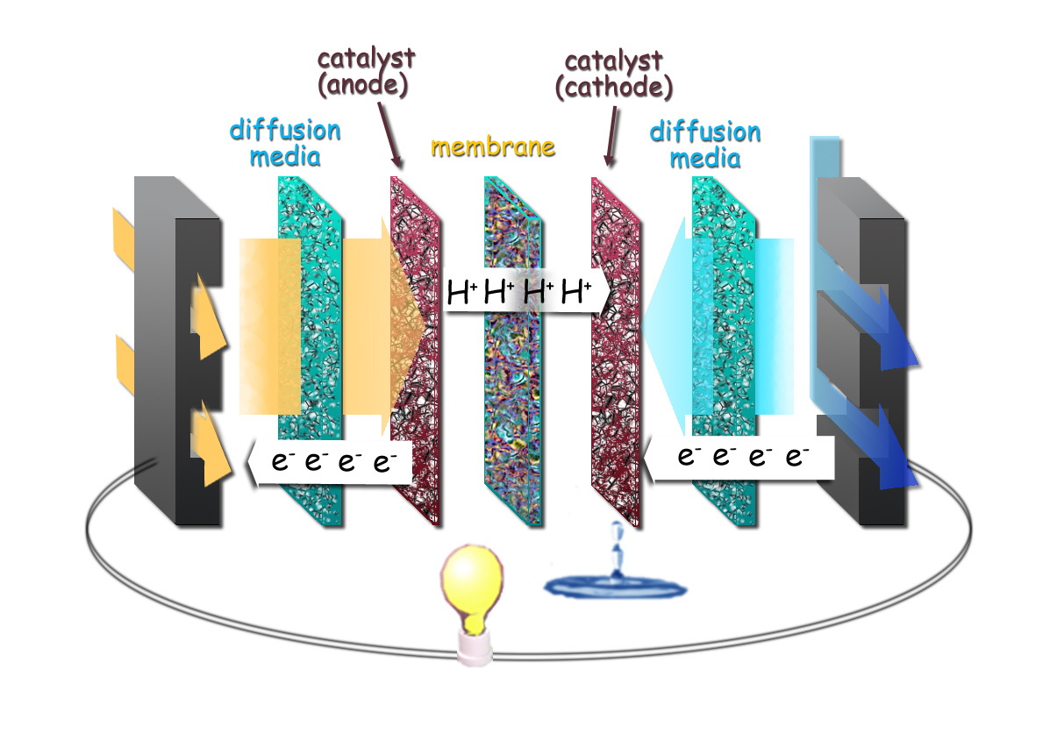
Our Specific Application
Fuel cells - Diffusion media, anode and cathode are porous materials, whose geometry can be important to the performance of the cell
Their geometry is captured using nanoscale X-ray CT imaging
Meshes are required to run simulations using that geometry
Possible applications also for 3D printing
Schematic of diffusion media, anode and catalyst in fuel cell
Streamlines showing results of a diffusion simulation in diffusion media

Slide 4
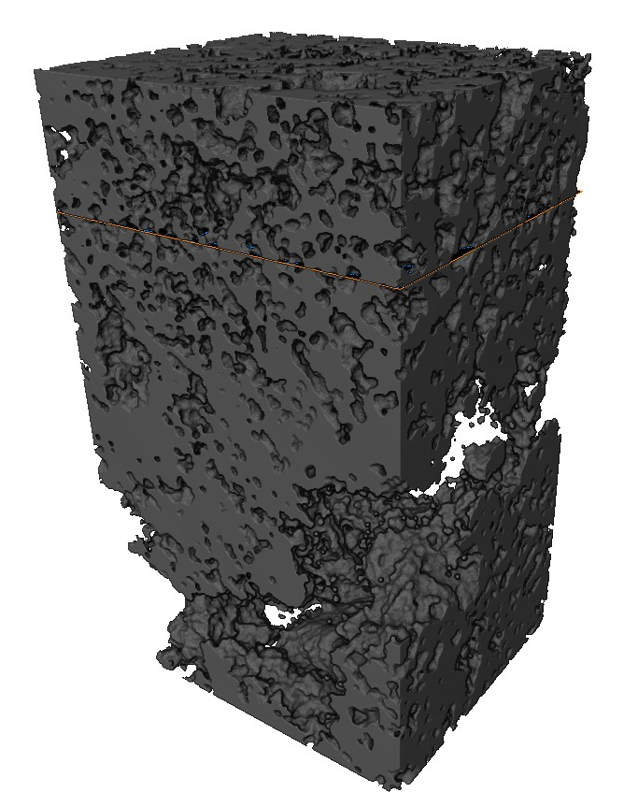
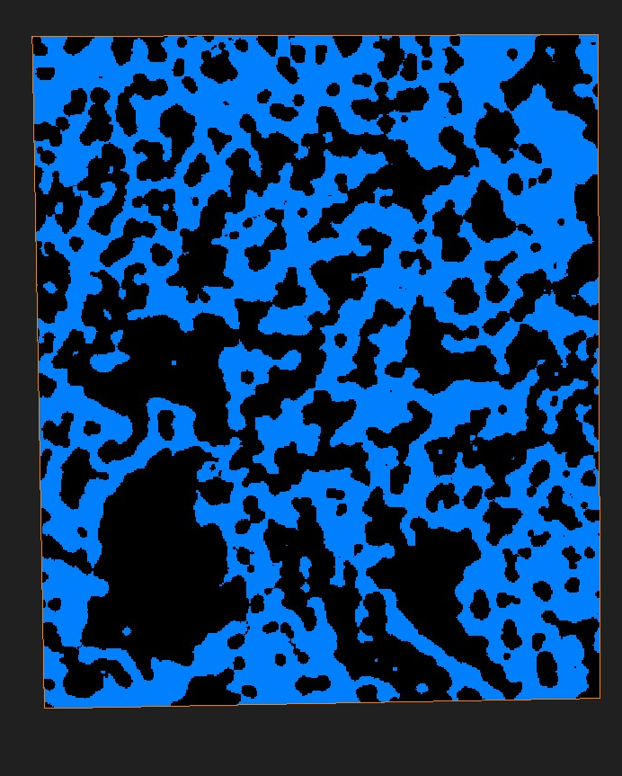
Input Image
We take a slice of a 3D image of cathode of fuel cell
We test our method with simple images for the slice of the 3D image
One of the things we hope to achieve is to mesh both solid and air phases that are conformal to the boundary to simulate interphase transport
Segmented 3D image of cathode and slice selection
Input 2D image for project (blue = solid)

Slide 5


Images for Testing

Slide 6
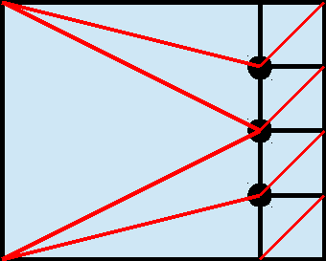
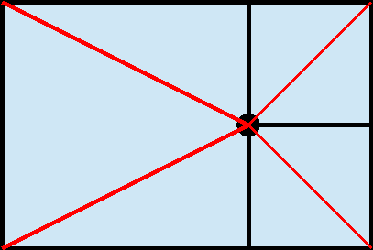
Pre-processing:
Quad-Tree Subdivision
For adaptive mesh generation, quadtree subdivision will allow us to use less triangles far away from the boundary and more more near the boundary
Hanging Node - limit to one for convenience and quality of triangles
Multiple One
Hanging Hanging
Nodes: Node:
Poor OK

Slide 7
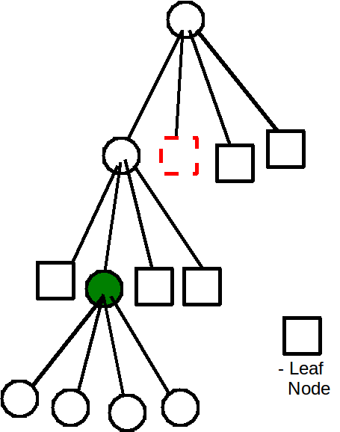
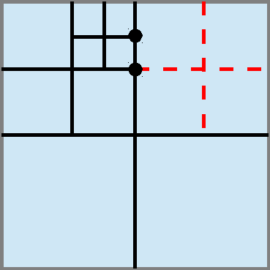
Subdivision Implementation
Breadth first search tree traversal
Have to traverse backwards to keep depth of tree balanced

Slide 8
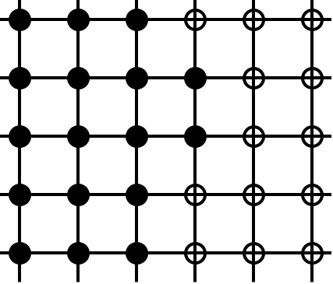
Transformation:
Method
Marching squares
One of the most widely used methods in mesh generation from image data
Marching squares visits each cell of input image, and generate one or more polygons for each cell that represents the material
Cell: each vertex has a value (0 or 1) to indicate material or air
Material (1): black dots
Air (0): circles

Slide 9
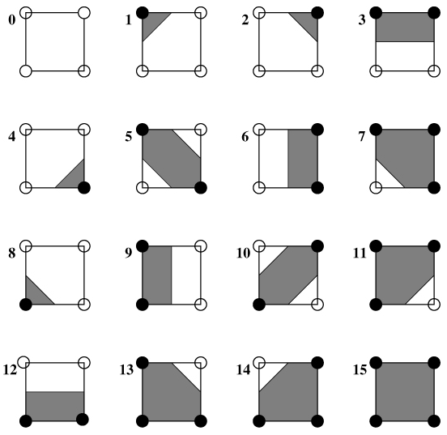
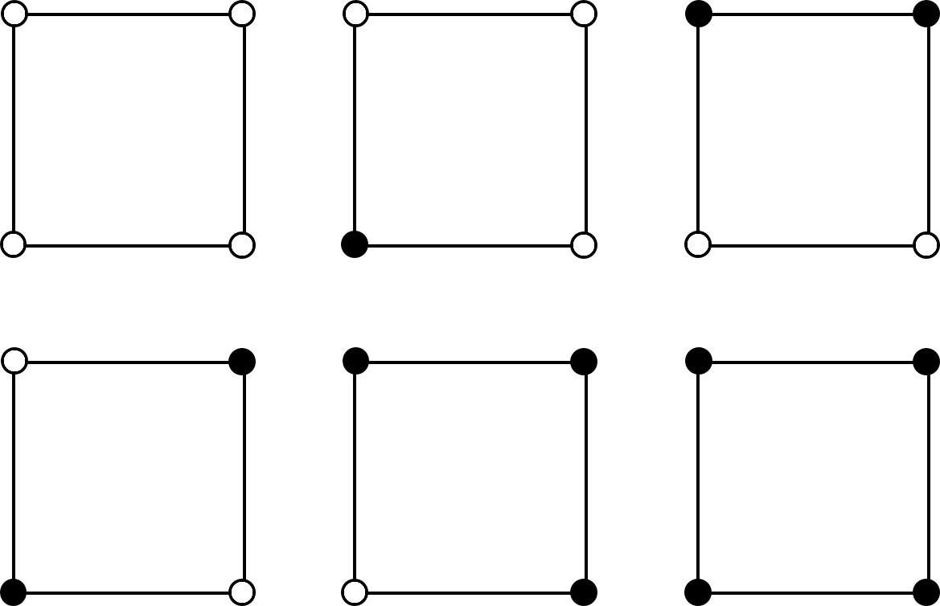
Transformation:
Method
Marching squares
Configuration of cells
16 cases depending on how vertices can be colored
Can be mapped to 6 cases

Slide 10
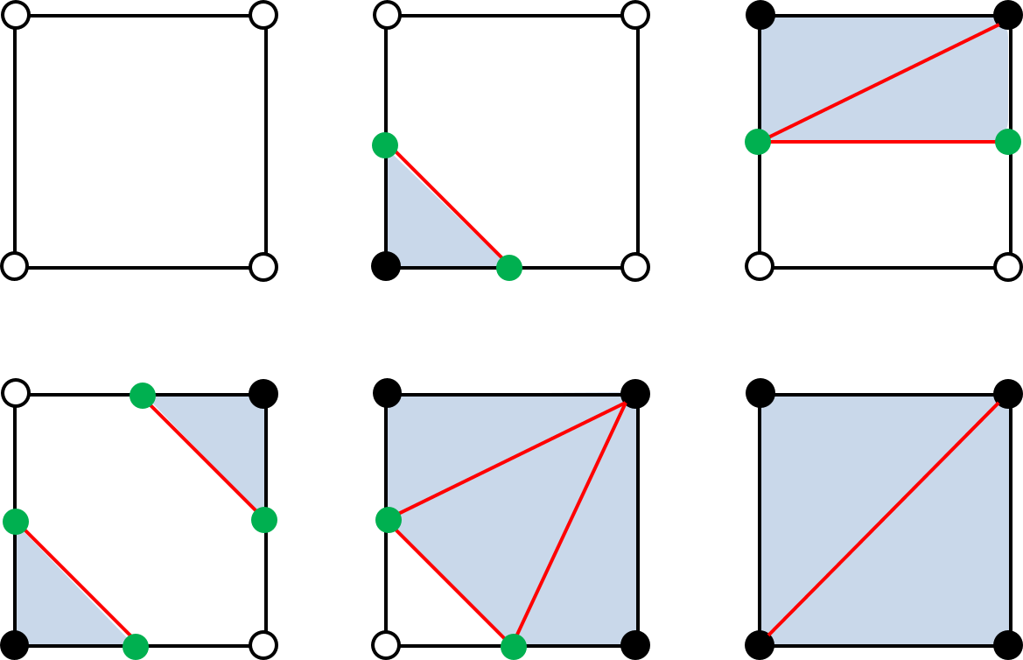
Transformation:
Method
Marching squares
Triangulation of cells
Generate middle points of color-changed edges (green dots)
Add edges to obtain triangles (blue)

Slide 11
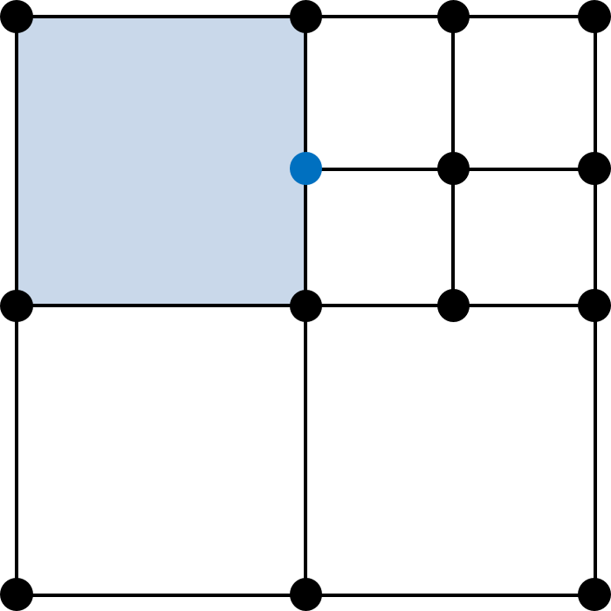
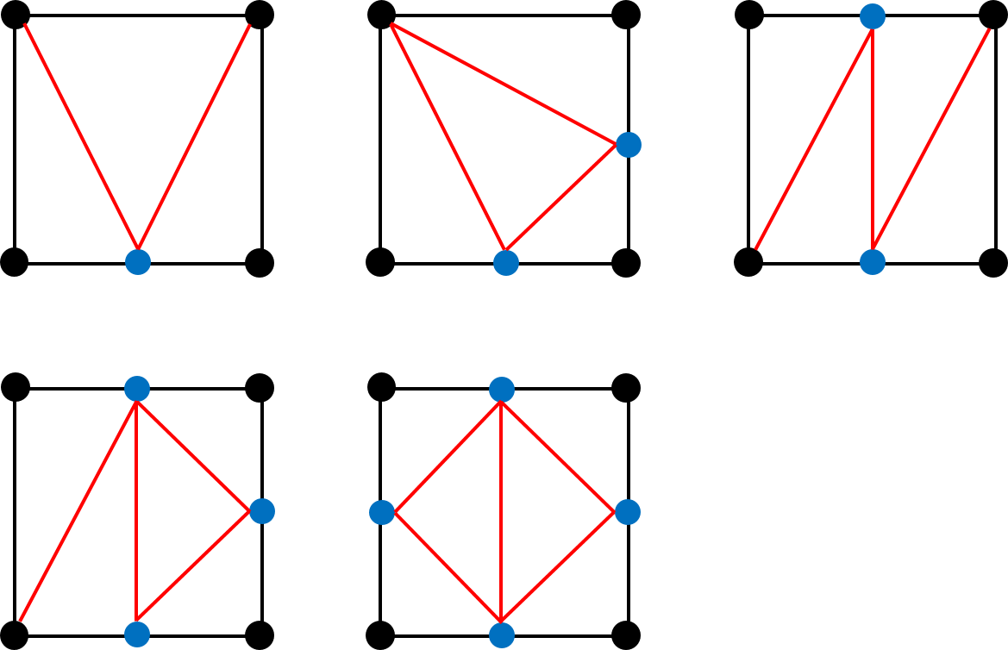
Transformation:
Method
Marching squares
Connection with quad-tree subdivision
Cells with hanging node on edges (blue dots)
Restrict at most one hanging node on one edge
5 cases depending on the position and number of handing nodes

Slide 12
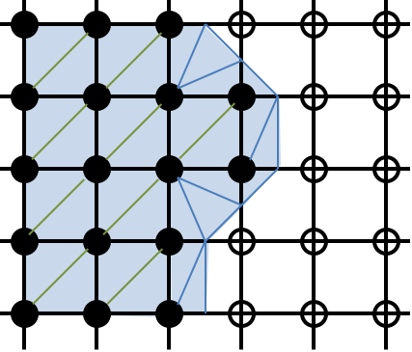
Transformation:
Method
Marching squares
Uniform mesh generation
Without quad-tree subdivision
Done
Adaptive mesh generation
With quad-tree subdivision

Slide 13
Post-processing:
STL and VRML File Generation
STL file
File with simple syntax to represent the generated mesh
No many feature for color, polynomial and other information
Not very effective to demonstrate our workflow
VRML file
File with many features to represent the geometric information
Large files for very complex geometry
Our major way to work on
Triangular Mesh
Rectangular Quad-Tree
Base Image

Slide 14
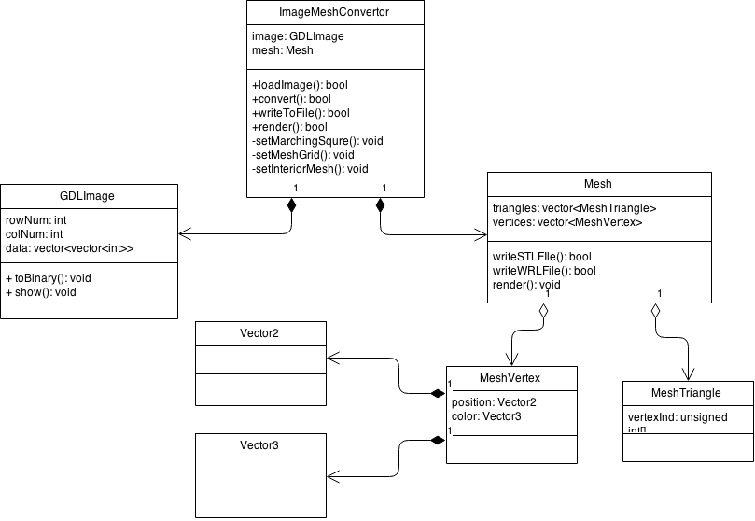
Object Model
Initial Design
ImageMeshConvertor
GDLImage
Mesh
Issues
No way to perform varied methods in concrete implementation
Objects are intervening with each other
Not good for task distribution for three members

Slide 15
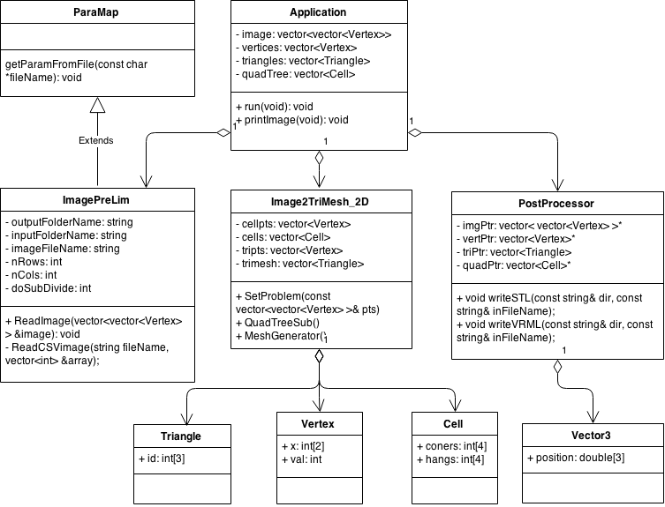
Object Model
Final Design
Application Class
Controller to store the shared data, invoke the major routines
ImagePreLie Class
Preprocessing class to read images and generate quad-trees
Image2TriMesh_2D Class
Transformation class to do image to mesh transformation
PostProcessor Class
Post-processing class to collect the data and generate files
Controller
Transformer
(Xiaodong)
Postprocessor
(Bo)
Preprocessor
(Arjun)

Slide 16
Implementation
Object Oriented Programming with C++
We are implementing the program with C++ in Linux Platform
Cmake to build the project
Build automation
Version Control & Collaboration
We are using Github to work on the project collaboratively, the URL of our project repository is in: https://github.com/bning/CADCourseProject
Open Source Resources
glm library for some geometric calculation
Cortona3D to render the images, quad-trees and meshes

Slide 17
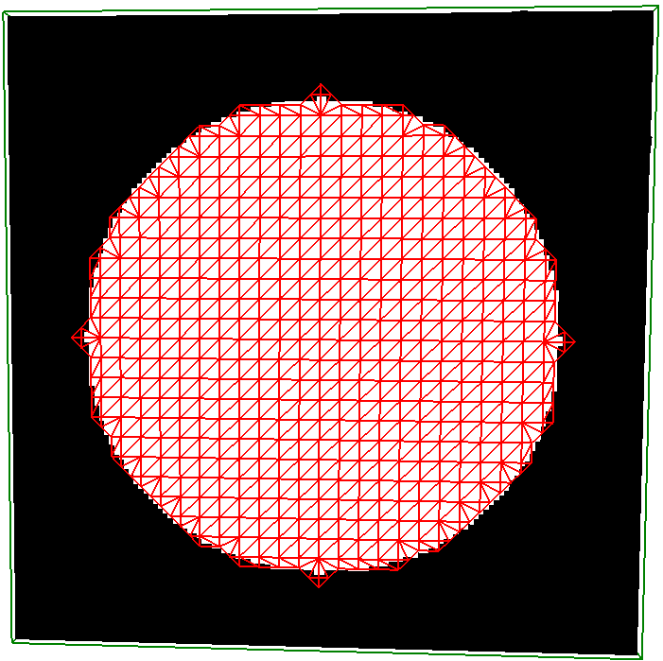
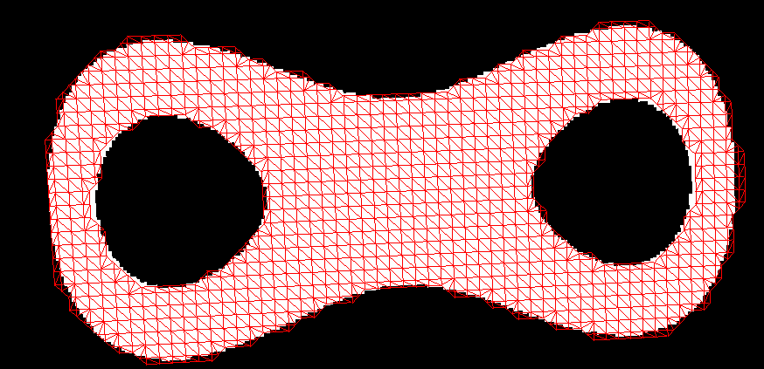
Results
Uniform Mesh Generation
TestCircle
TestDoubleTorus

Slide 18
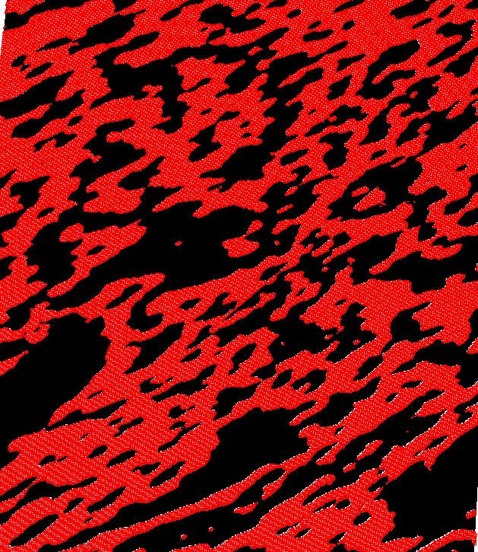
Results
Issues
Not representative for the details and fine regions
Low efficiency in transformation and post-processing
Would give very large files that are slow to load and render
GDLImage

Slide 19
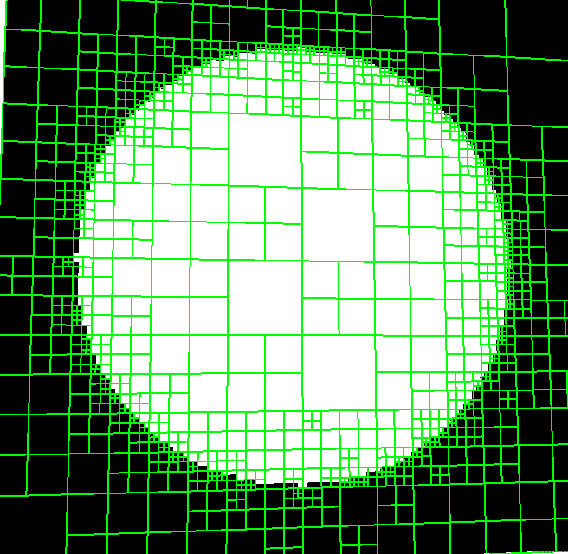
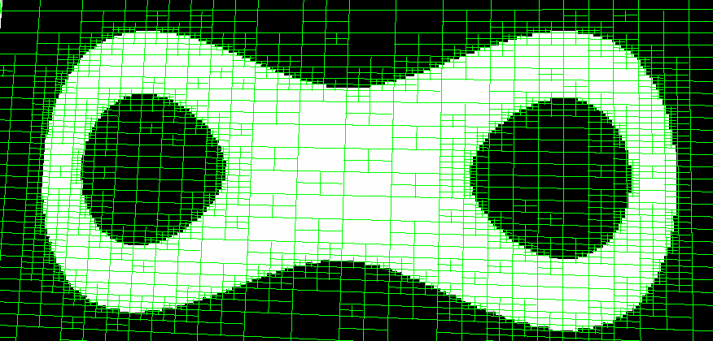
Results
Quadtree for adaptive mesh generation
TestCircle
TestDoubleTorus

Slide 20
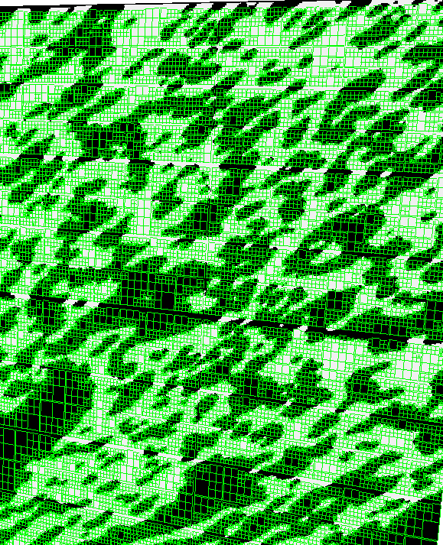
Results
Quadtree for
adaptive mesh generation
GDLImage

Slide 21
Thanks
Questions?

